Slide 1
Combinational Logic II
Optimization
CSCI 2050U - Computer Architecture
Randy J. Fortier
@randy_fortier

Slide 2
Outline
Optimization
Algebraic simplification
Karnaugh maps
Common components

Slide 3
Optimization
CSCI 2050U - Computer Architecture

Slide 4
Boolean Algebraic Simplification
Boolean algebraic simplification is one way to optimize a circuit
Simplification involves using a set of axioms/logical equivalences to eliminate operators, or even variables from an expression
A smaller expression normally translates to a simpler/cheaper circuit
The resulting expression must be logically equivalent

Slide 5
Boolean Algebraic Simplification
Some axioms are intuitive:
AND Form | OR Form | Name
1x = x | 0 + x = x | Identity law
0x = 0 | 1 + x = 1 | Null law
xx = x | x + x = x | Idempotent law
xx’ = 0 | x + x’ = 1 | Inverse law

Slide 6
Boolean Algebraic Simplification
Some axioms are intuitive:
AND Form | Name
x’’ = x | Double complement law

Slide 7
Boolean Algebraic Simplification
Other axioms are familiar from (non-Boolean) algebra:
AND Form | OR Form | Name
xy = yx | x + y = y + x | Commutative law
(xy)z = x(yz) | (x + y) + z = x + (y + z) | Associative law
x + yz = (x + y)(x + z) | x(y + z) = xy + xz | Distributive law
Notes:
Note the bottom left example is not exactly the same as non-Boolean algebra, but makes sense if you think about it.

Slide 8
Boolean Algebraic Simplification
Others have been proved by Mathematicians:
AND Form | OR Form | Name
x(x + y) = x | x + xy = x | Absorption law
(xy)’ = x’ + y’ | (x + y)’ = x’y’ | DeMorgan’s law

Slide 9
Boolean Algebraic Simplification
Let’s do an example:
f(x,y,z) = xy + x’z + yz
= xy + x’z + yz1 (identity)
= xy + x’z + yz(x + x’) (inverse)
= xy + x’z + yzx + yzx’ (distributive)
= xy + x’z + x(yz) + x’(yz) (commutative x2)
= xy + x’z + (xy)z + (x’z)y (associative x2)
= xy + (xy)z + x’z + (x’z)y (commutative)
= xy(1 + z) + x’z(1 + y) (distributive x2)
= xy1 + x’z1 (null x2)
= xy + x’z (identity x2)

Slide 10
Boolean Algebraic Simplification
Let’s do another example (our Neg expression from earlier):
f(x,y,z) = xy’z’ + xy’z + xyz’ + xyz
= xy’(z’+z) + xy(z’+z) (distributive x 2)
= xy’1 + xy1 (inverse x 2)
= xy’ + xy (identity x 2)
= x(y’+y) (distributive)
= x1 (inverse)
= x (identity)
Notes:
f(x,y,z) = xy’z’ + xy’z + xyz’ + xyz
= xy’(z’ + z) + xy(z’ + z) (distributive)
= xy’1 + xy1 (inverse)
= xy’ + xy (identity)
= x(y’ + y) (distributive)
= x1 (inverse)
= x (identity)

Slide 11
Boolean Algebraic Simplification
The main problem with Boolean algebraic simplification is that it is not obvious what to do next
We need an oracle to tell us which axiom to use next
This is not a algorithmic approach
We need something systematic, so we can never fail if we follow the steps

Slide 12
Karnaugh Maps (K-Maps)
A K-map is a systematic way of simplifying Boolean algebraic expressions (in SOP form; alternatively truth tables)
First, we draw a sort of coiled-up truth table:
x
x | y | xy + xy’
0 | 0 | 0
0 | 1 | 0
1 | 0 | 1
1 | 1 | 1
y
0
1
0
0 | 1
0 | 1
1

Slide 13
Karnaugh Maps (K-Maps)
Next, we look for rectangles that are made entirely of 1s
We look only for rectangles that are size 2^{n} (for any n)
We prefer rectangles that are larger over smaller rectangles
x
x | y | xy + xy’
0 | 0 | 0
0 | 1 | 0
1 | 0 | 1
1 | 1 | 1
y
0
1
0
0 | 1
0 | 1
1

Slide 14
Karnaugh Maps (K-Maps)
Next, we look for rectangles that are made entirely of 1s
This K-map has 4 spots
Does it have any rectangles of size 4? (e.g. 2x2)
x
x | y | xy + xy’
0 | 0 | 0
0 | 1 | 0
1 | 0 | 1
1 | 1 | 1
y
0
1
0
0 | 1
0 | 1
1

Slide 15
Karnaugh Maps (K-Maps)
Next, we look for rectangles that are made entirely of 1s
This K-map has 4 spots
Does it have any rectangles of size 4? (e.g. 2x2) No (there is only one)
x
x | y | xy + xy’
0 | 0 | 0
0 | 1 | 0
1 | 0 | 1
1 | 1 | 1
y
0
1
0
0 | 1
0 | 1
1

Slide 16
Karnaugh Maps (K-Maps)
Next, we look for rectangles that are made entirely of 1s
This K-map has 4 spots
Does it have any rectangles of size 2? (e.g. 1x2 or 2x1)
x
x | y | xy + xy’
0 | 0 | 0
0 | 1 | 0
1 | 0 | 1
1 | 1 | 1
y
0
1
0
0 | 1
0 | 1
1

Slide 17
Karnaugh Maps (K-Maps)
Next, we look for rectangles that are made entirely of 1s
This K-map has 4 spots
Does it have any rectangles of size 2? (e.g. 1x2 or 2x1) Yes
Every rectangle can be represented by an expression
What is the expression in this case?
x
x | y | xy + xy’
0 | 0 | 0
0 | 1 | 0
1 | 0 | 1
1 | 1 | 1
y
0
1
0
0 | 1
0 | 1
1

Slide 18
Karnaugh Maps (K-Maps)
Next, we look for rectangles that are made entirely of 1s
Both of these 1s represent different values for y
… but they also both represent the same value of x
In fact, the rectangle covers every situation where x = 1
The expression, therefore, is x (x=0 would be x’)
x
x | y | xy + xy’
0 | 0 | 0
0 | 1 | 0
1 | 0 | 1
1 | 1 | 1
y
0
1
0
0 | 1
0 | 1
1

Slide 19
Karnaugh Maps (K-Maps)
Next, we look for rectangles that are made entirely of 1s
Since the rectangle we just found covers all of the 1s in the K-map, we are done
The simplified expression is, therefore, f(x,y) = x
Note: Rectangles can, and often do, overlap
x
x | y | xy + xy’
0 | 0 | 0
0 | 1 | 0
1 | 0 | 1
1 | 1 | 1
y
0
1
0
0 | 1
0 | 1
1

Slide 20
Karnaugh Maps (K-Maps)
Another example: g(a,b) = xy + x’y + xy’
Let’s fill in the K-map:
g(a,b) = x + y
x
x | y | xy + x’y + xy’
0 | 0 | 0
0 | 1 | 1
1 | 0 | 1
1 | 1 | 1
y
0
1
0
0 | 1
1 | 1
1

Slide 21
Karnaugh Maps (K-Maps)
Another example: g(a,b) = xy + x’y + xy’
Any rectangles of size 4?
x
x | y | xy + x’y + xy’
0 | 0 | 0
0 | 1 | 1
1 | 0 | 1
1 | 1 | 1
y
0
1
0
0 | 1
1 | 1
1

Slide 22
Karnaugh Maps (K-Maps)
Another example: g(a,b) = xy + x’y + xy’
Any rectangles of size 4? No
Any rectangles of size 2?
x
x | y | xy + x’y + xy’
0 | 0 | 0
0 | 1 | 1
1 | 0 | 1
1 | 1 | 1
y
0
1
0
0 | 1
1 | 1
1

Slide 23
Karnaugh Maps (K-Maps)
Another example: g(a,b) = xy + x’y + xy’
Any rectangles of size 4? No
Any rectangles of size 2? Yes
What is the expression for this rectangle?
x
x | y | xy + x’y + xy’
0 | 0 | 0
0 | 1 | 1
1 | 0 | 1
1 | 1 | 1
y
0
1
0
0 | 1
1 | 1
1

Slide 24
Karnaugh Maps (K-Maps)
Another example: g(a,b) = xy + x’y + xy’
Any rectangles of size 4? No
Any rectangles of size 2? Yes
What is the expression for this rectangle? x
x
x | y | xy + x’y + xy’
0 | 0 | 0
0 | 1 | 1
1 | 0 | 1
1 | 1 | 1
y
0
1
0
0 | 1
1 | 1
1

Slide 25
Karnaugh Maps (K-Maps)
Another example: g(a,b) = xy + x’y + xy’
Any rectangles of size 4? No
Any more rectangles of size 2?
x
x | y | xy + x’y + xy’
0 | 0 | 0
0 | 1 | 1
1 | 0 | 1
1 | 1 | 1
y
0
1
0
0 | 1
1 | 1
1

Slide 26
Karnaugh Maps (K-Maps)
Another example: g(a,b) = xy + x’y + xy’
Any rectangles of size 4? No
Any more rectangles of size 2? Yes
What is the expression for this rectangle? y
x
x | y | xy + x’y + xy’
0 | 0 | 0
0 | 1 | 1
1 | 0 | 1
1 | 1 | 1
y
0
1
0
0 | 1
1 | 1
1

Slide 27
Karnaugh Maps (K-Maps)
Another example: g(a,b) = xy + x’y + xy’
Any rectangles of size 4? No
Any more rectangles of size 2? Yes
What if just added a 1x1 rectangle, instead?
This expression is x’y (this is not as much of an improvement)
x
x | y | xy + x’y + xy’
0 | 0 | 0
0 | 1 | 1
1 | 0 | 1
1 | 1 | 1
y
0
1
0
0 | 1
1 | 1
1

Slide 28
Karnaugh Maps (K-Maps)
Another example: g(a,b) = xy + x’y + xy’
Are we done?
x
x | y | xy + x’y + xy’
0 | 0 | 0
0 | 1 | 1
1 | 0 | 1
1 | 1 | 1
y
0
1
0
0 | 1
1 | 1
1

Slide 29
Karnaugh Maps (K-Maps)
Another example: g(a,b) = xy + x’y + xy’
Are we done? Yes, because all 1s have been covered by rectangles
x
x | y | xy + x’y + xy’
0 | 0 | 0
0 | 1 | 1
1 | 0 | 1
1 | 1 | 1
y
0
1
0
0 | 1
1 | 1
1

Slide 30
Karnaugh Maps (K-Maps)
Another example: g(a,b) = xy + x’y + xy’
Are we done? Yes, because all 1s have been covered by rectangles
Note: We could add another rectangle here, but that would be unnecessary since we have covered all 1s already
x
x | y | xy + x’y + xy’
0 | 0 | 0
0 | 1 | 1
1 | 0 | 1
1 | 1 | 1
y
0
1
0
0 | 1
1 | 1
1

Slide 31
Karnaugh Maps (K-Maps)
Another example: g(a,b) = xy + x’y + xy’
Are we done? Yes, because all 1s have been covered by rectangles
Therefore, g(a,b) = x + y
x
x | y | xy + x’y + xy’
0 | 0 | 0
0 | 1 | 1
1 | 0 | 1
1 | 1 | 1
y
0
1
0
0 | 1
1 | 1
1

Slide 32
Karnaugh Maps (K-Maps)
K-maps for 3 variables have a notational quirk:
x | y | z | xy + x’z + yz
0 | 0 | 0 | 0
0 | 0 | 1 | 1
0 | 1 | 0 | 0
0 | 1 | 1 | 1
1 | 0 | 0 | 0
1 | 0 | 1 | 0
1 | 1 | 0 | 1
1 | 1 | 1 | 1
xy
z
00
01
11
10
0
0 | 0 | 1 | 0
1 | 1 | 1 | 0
1

Slide 33
Karnaugh Maps (K-Maps)
K-maps for 3 variables have a notational quirk:
x | y | z | xy + x’z + yz
0 | 0 | 0 | 0
0 | 0 | 1 | 1
0 | 1 | 0 | 0
0 | 1 | 1 | 1
1 | 0 | 0 | 0
1 | 0 | 1 | 0
1 | 1 | 0 | 1
1 | 1 | 1 | 1
Note the unusual order, here:
xy
z
00
01
11
10
0
0 | 0 | 1 | 0
1 | 1 | 1 | 0
1
Notes:
Please note that 3-variables could be represented with a 3-dimensional shape, but this does not scale to 4 or more variables (at least not for us humans).

Slide 34
Karnaugh Maps (K-Maps)
Let’s continue this example
Are there any size 8 rectangles? (remember, the rectangles must be of size 2^{n})
xy
z
00
01
11
10
0
0 | 0 | 1 | 0
1 | 1 | 1 | 0
1

Slide 35
Karnaugh Maps (K-Maps)
Let’s continue this example
Are there any size 8 rectangles? No
Are there any size 4 rectangles?
xy
z
00
01
11
10
0
0 | 0 | 1 | 0
1 | 1 | 1 | 0
1

Slide 36
Karnaugh Maps (K-Maps)
Let’s continue this example
Are there any size 8 rectangles? No
Are there any size 4 rectangles? No
xy
z
00
01
11
10
0
0 | 0 | 1 | 0
1 | 1 | 1 | 0
1

Slide 37
Karnaugh Maps (K-Maps)
Let’s continue this example
Are there any size 8 rectangles? No
Are there any size 4 rectangles? No
Are there any size 2 rectangles?
xy
z
00
01
11
10
0
0 | 0 | 1 | 0
1 | 1 | 1 | 0
1

Slide 38
Karnaugh Maps (K-Maps)
Let’s continue this example
Are there any size 8 rectangles? No
Are there any size 4 rectangles? No
Are there any size 2 rectangles? Yes
xy
x’z
yz
xy
z
00
01
11
10
0
0 | 0 | 1 | 0
1 | 1 | 1 | 0
1

Slide 39
Karnaugh Maps (K-Maps)
Let’s continue this example
Are there any size 8 rectangles? No
Are there any size 4 rectangles? No
Are there any size 2 rectangles? Yes
xy
x’z
yz
Right?
xy
z
00
01
11
10
0
0 | 0 | 1 | 0
1 | 1 | 1 | 0
1

Slide 40
Karnaugh Maps (K-Maps)
Let’s continue this example
Are there any size 8 rectangles? No
Are there any size 4 rectangles? No
Are there any size 2 rectangles? Yes
xy
x’z
yz
Right? No! The term yz is unnecessary
h(x,y,z) = xy + x’z
xy
z
00
01
11
10
0
0 | 0 | 1 | 0
1 | 1 | 1 | 0
1

Slide 41
Karnaugh Maps (K-Maps)
4-variable K-maps look like this:
f(a,b,c,d) = abc’d’ + abc’d + abcd + abcd’ + a’bc’d + a’bcd + a’b’c’d + ab’c’d
Note: We will not do K-maps for any expressions beyond 4 variables
ab
cd
00
01
11
10
00
0 | 0 | 1 | 0
1 | 1 | 1 | 1
0 | 1 | 1 | 0
0 | 0 | 1 | 0
01
11
10
Notes:
Let’s simplify this one, as another example

Slide 42
Karnaugh Maps (K-Maps)
Truth tables can sometimes have don’t care conditions
When this happens, we can treat it as either a 0 or a 1
Whichever is more convenient for finding our rectangles
In this example, the ? should be a 1 since it enables this 1x4 rectangle
ab
cd
00
01
11
10
00
0 | 0 | 1 | 0
1 | ? | 1 | 1
0 | 1 | 1 | 0
0 | 0 | 1 | 0
01
11
10

Slide 43
Karnaugh Maps (K-Maps)
K-maps have one other confusing aspect for students
The positions in this table are adjacent because the values next to each other (horizontally or vertically) differ by exactly one bit
Notice that the left and right columns for 3 or 4-variable k-maps (and the top and bottom rows) also differ by exactly one bit
ab
cd
00
01
11
10
00
0 | 0 | 1 | 0
1 | 0 | 0 | 1
1 | 0 | 0 | 1
0 | 0 | 1 | 0
01
11
10
Notes:
Let’s simplify this one, as another example

Slide 44
Karnaugh Maps (K-Maps)
K-maps have one other confusing aspect for students
As a consequence, these are valid rectangles:
ab
cd
00
01
11
10
00
0 | 0 | 1 | 0
1 | 0 | 0 | 1
1 | 0 | 0 | 1
0 | 0 | 1 | 0
01
11
10

Slide 45
Karnaugh Maps (K-Maps)
K-maps have one other confusing aspect for students
As a consequence, these are valid rectangles
… and so is this:
ab
cd
00
01
11
10
00
0 | 0 | 1 | 0
1 | 0 | 0 | 1
1 | 0 | 0 | 1
0 | 0 | 1 | 0
01
11
10

Slide 46
Common Components
CSCI 2050U - Computer Architecture

Slide 47
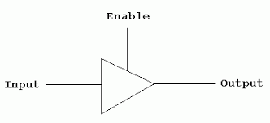
Tri-state Buffer
A tri-state buffer is a component, much like a buffer, that does not change the value on the line
However, it can block the value so that there is no value

Slide 48
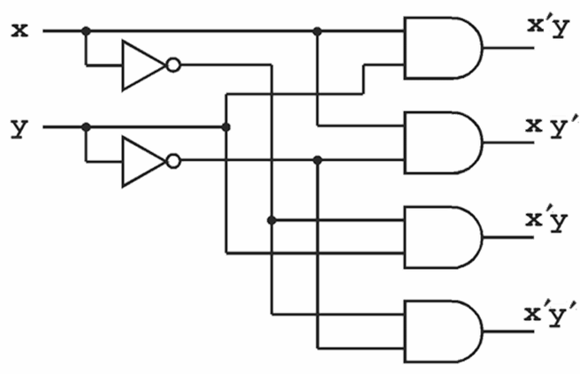
Decoders
A decoder (DEC) is a component which activates (i.e. voltage high, e.g. 5v) one of its output lines for each unique input combination
Inputs: n
Outputs: 2^{n}

Slide 49
Decoders
A decoder is a component which activates (i.e. voltage high, e.g. 5v) one of its output lines for each unique input combination
This is a 2-to-4 line decoder
11
10
01
00

Slide 50
Decoders
A decoder is often used for two important purposes:
Decoding an instruction, enabling the correct ALU circuit
Decoding a memory address, enabling the inputs and/or outputs of the correct memory cell

Slide 51
Decoders
Decoders and other components can be drawn in block notation
This abstraction simplifies our job as we move to more complex circuits
DEC

Slide 52
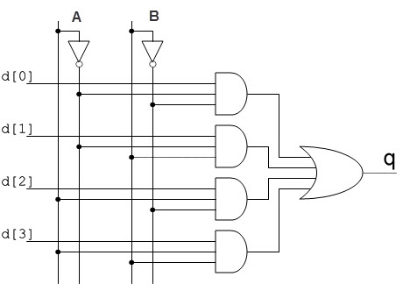
Multiplexer
A multiplexer (MUX) is a component with many inputs and only one output
This is a 4-to-1 multiplexer
Selector bits (A and B in the diagram, below) decide which input gets mapped to the output
Selector bits: n
Input bits: 2^{n}
input₁
input₂
output
input₃
input₄

Slide 53
Multiplexer
The multiplexer in block notation:
MUX
input₁
input₂
output
input₃
input₄

Slide 54
Half Adder
A half adder (HA) can add two bits together
Inputs:
A and B: The two bits to add
Outputs:
S: The sum of the two bits
C: Carry (1 if there was a carry, 0 if not)

Slide 55
Half Adder
A half adder can add two bits together
A | B | S | C
0 | 0 | 0 | 0
0 | 1 | 1 | 0
1 | 0 | 1 | 0
1 | 1 | 0 | 1

Slide 56
Half Adder
A half adder can add two bits together
Recognize this truth table?
A | B | S | C
0 | 0 | 0 | 0
0 | 1 | 1 | 0
1 | 0 | 1 | 0
1 | 1 | 0 | 1

Slide 57
Half Adder
A half adder can add two bits together
Recognize this truth table? S = A’B + AB’ = A ⊕ B
A | B | S | C
0 | 0 | 0 | 0
0 | 1 | 1 | 0
1 | 0 | 1 | 0
1 | 1 | 0 | 1

Slide 58
Half Adder
A half adder can add two bits together
Recognize this truth table? C = AB
A | B | S | C
0 | 0 | 0 | 0
0 | 1 | 1 | 0
1 | 0 | 1 | 0
1 | 1 | 0 | 1

Slide 59
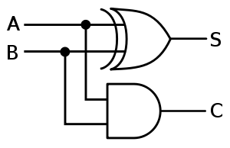
Half Adder
A half adder circuit:
S = A’B + AB’ = A ⊕ B
C = AB

Slide 60
Half Adder
A half adder in block notation:
HA

Slide 61
Full Adder
Why do they call it a half adder?
To find the answer to this, we need to try to add two multi-bit numbers
Let’s add 0001 and 0110:
0011
+0111

Slide 62
Full Adder
Why do they call it a half adder?
To find the answer to this, we need to try to add two multi-bit numbers
Let’s add 0001 and 0110:
Adding the rightmost two bits can be done with a half adder
₁
0011
+0111
0

Slide 63
Full Adder
Why do they call it a half adder?
To find the answer to this, we need to try to add two multi-bit numbers
Let’s add 0001 and 0110:
Adding the rightmost two bits can be done with a half adder
What about the next two bits?
₁ ₁
0011
+0111
10

Slide 64
Full Adder
Why do they call it a half adder?
To find the answer to this, we need to try to add two multi-bit numbers
Let’s add 0001 and 0110:
Adding the rightmost two bits can be done with a half adder
What about the next two bits?
We really need to add three bits, in the general case
For this we need a new component: the full adder (FA)
₁ ₁
0011
+0111
10

Slide 65
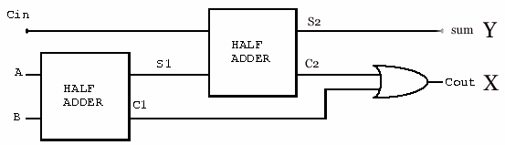
Full Adder
A full adder (FA) adds three bits
Inputs:
A and B: The bits to be added
C_{in}: A carry from a previous add, which also must be added
Outputs:
S: The sum of the three bits
C_{out}: Whether or not the sum resulted in a carry bit
HA
HA

Slide 66
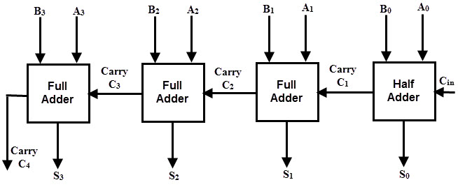
Full Adder
We could have drawn this entire circuit using XOR, AND, and OR gates
This is our first circuit, drawn using block notation
This is called a ripple carry adder

Slide 67
Wrap-Up
Optimization
Algebraic simplification
Karnaugh maps
Common components

